Slide 1


ECEN 215 Lab Kit Luis Diaz-Santini, Yusuf Hossain, Ryan Freed, Peter Zhang

Slide 2
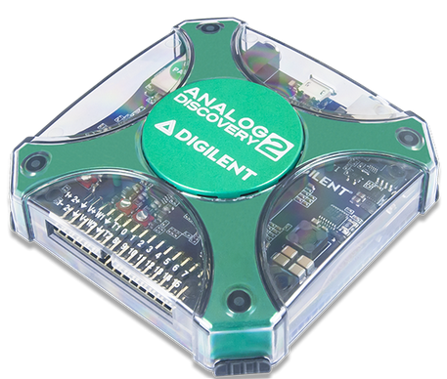
Problem Statement
Principles of Electrical Engineering (ECEN 215) teaches the basics of electric circuit analysis and electronics to non-ECEN majors.
The transition of ECEN 215 to an online format poses a challenge due to its lab component relying on the Analog Discovery 2 (AD2), which is expensive. The need for a more cost-effective alternative for remote lab work becomes essential to ensure accessibility and affordability for students in ECEN 215.

Slide 3
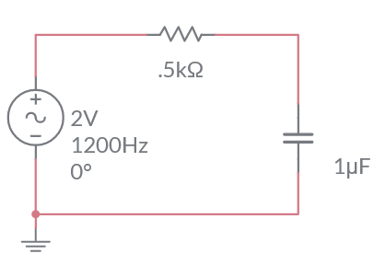
Solution Proposal
The ECEN 215 Lab Kit offers a solution to the cost, convenience, and over complication issues that are abundant with the AD2. Aiming for a $50 price point, the lab kit offers a more catered simpler approach to each lab while also making it possible to complete at home.
Will operate as the power supply, signal generator, multimeter, and Oscilloscope.

Slide 4
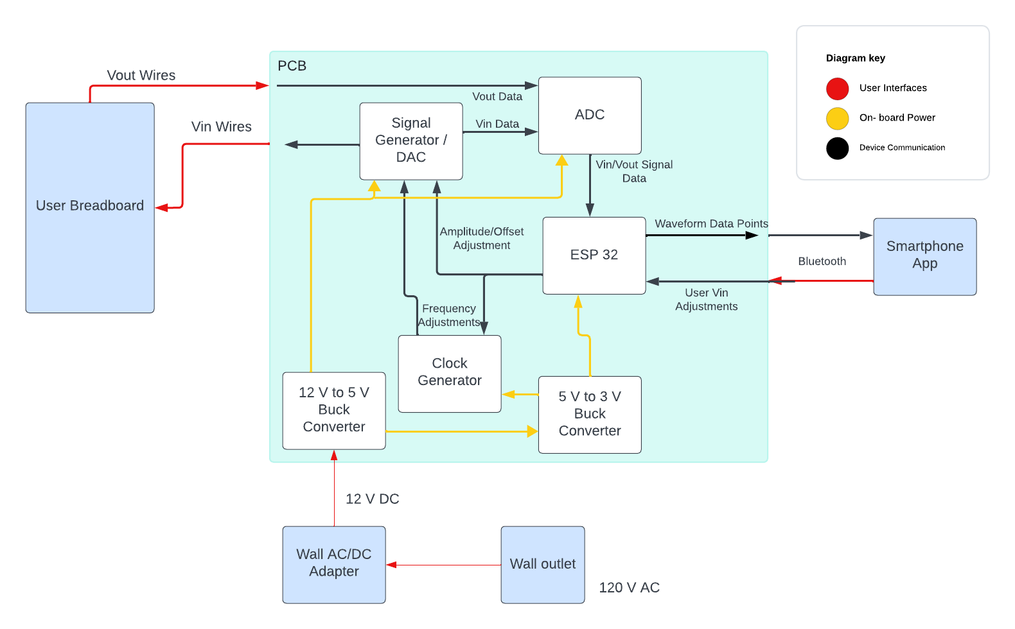
Diagram of Subsystems and Interface

Slide 5
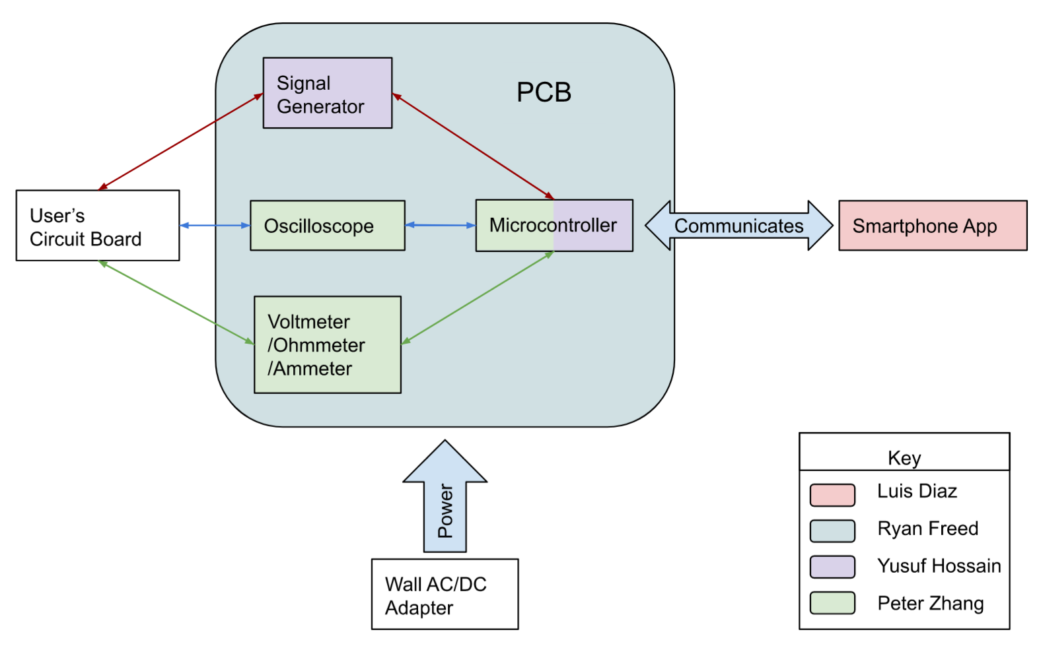
Task partition
Peter: Create the multimeter and oscilloscope functions.
Yusuf: Generate waveforms while communicating to the microcontroller.
Luis: Create mobile application to interface with device,
Ryan: PCB design and power.

Slide 6
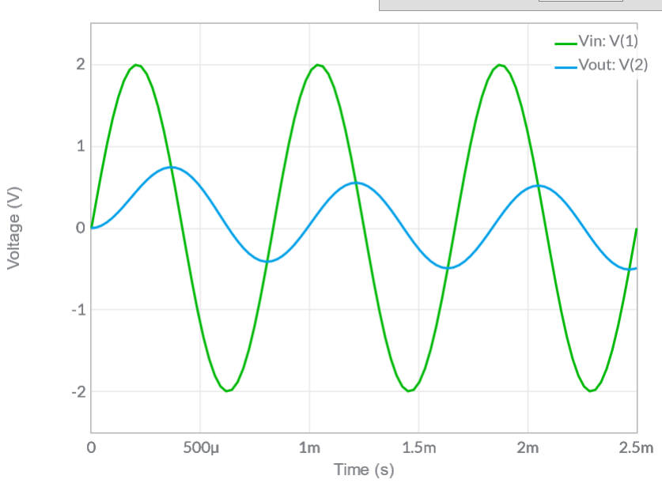
Oscilloscope and Multimeter Subsystem
Multimeter: Produce multimeter capable of measuring current, resistance, and voltage.
Oscilloscope: Design an oscilloscope capable of measuring over 10 MHz.
Measured data is transferred to the microcontroller.

Slide 7
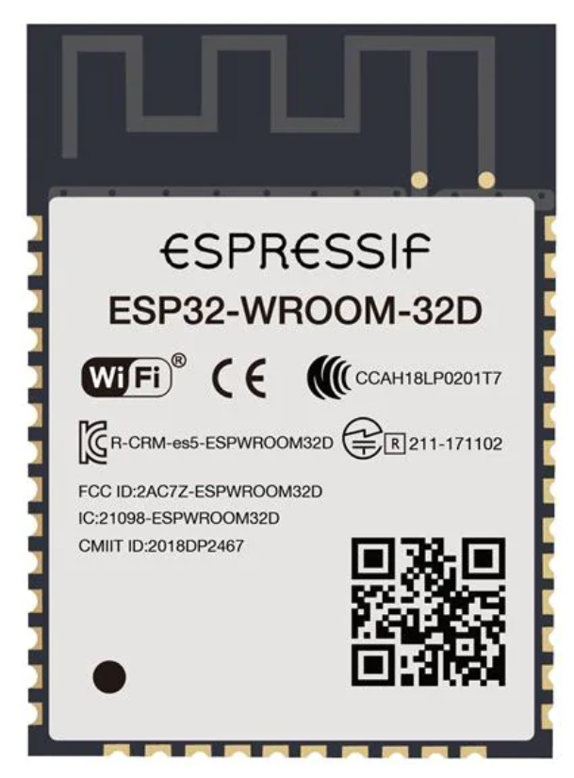
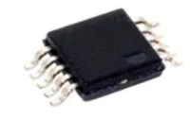
Waveform Generator and Microcontroller Subsystem
Waveform Generator: Generate AC and DC waveforms in a range of frequencies. Capable of producing sine, square, and triangle waves, along with + and - 5 V DC.
Microcontroller: Communicate with all other subsystems and sends information to the app via bluetooth.

Slide 8
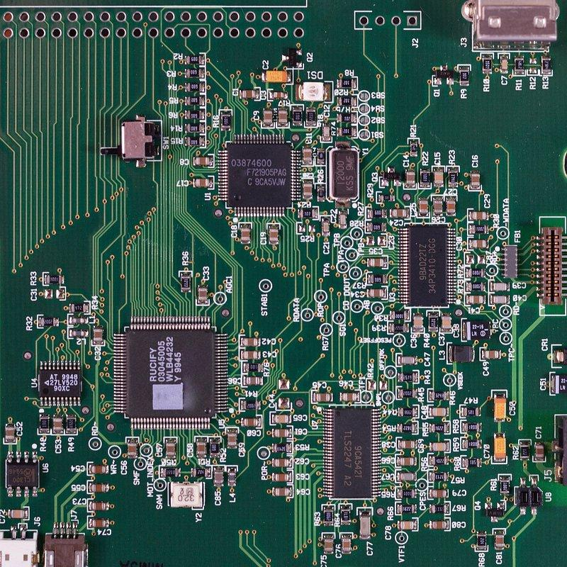
Board Layout Subsystem
Board Power: Design and implement buck converters to supply ICs.
PCB Design: Manage IC communication networks, implement any amplifiers or intermediaries necessary for device operation.

Slide 9
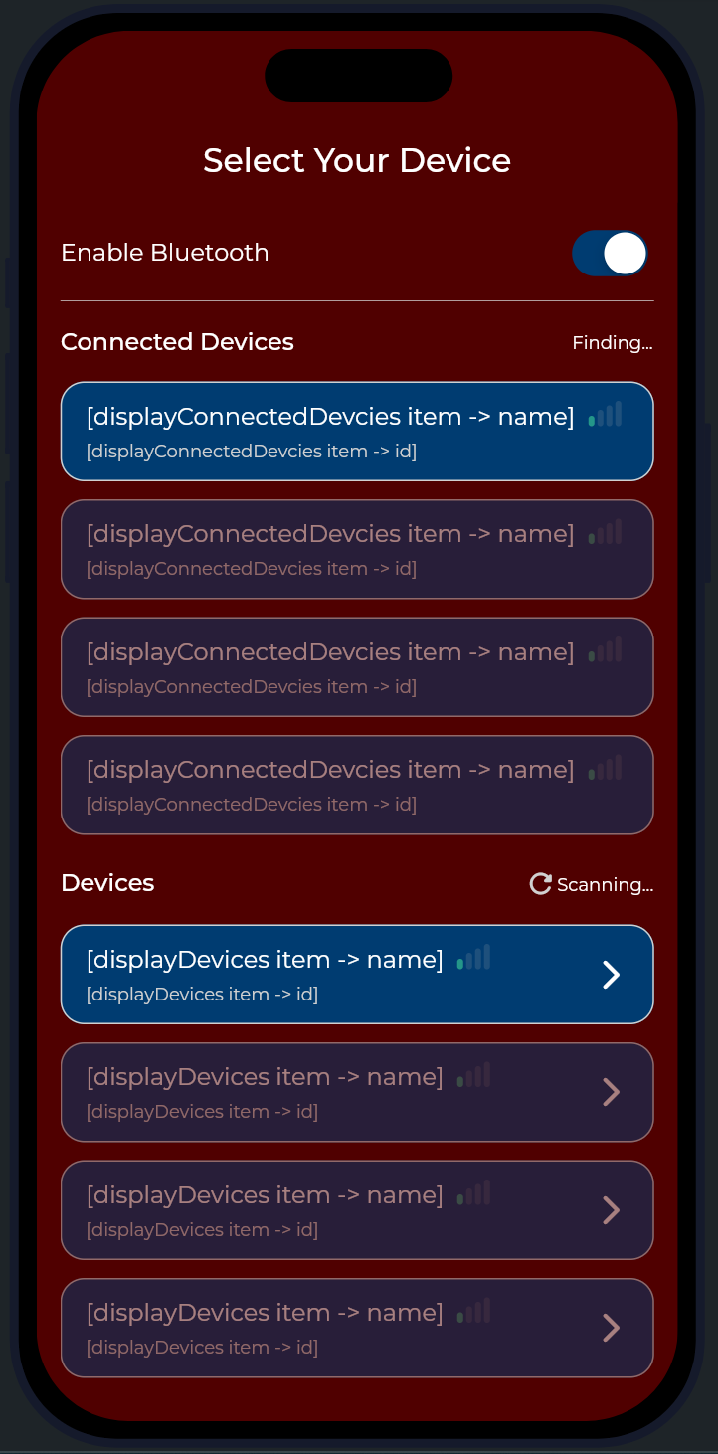
Software Subsystem
Communication via Bluetooth
Attractive GUI: Design an attractive and responsive graphical user interface that presents data accurately.
Receiving data from lab kit: Receive measurements from the lab kit device.
Sending commands to lab kit: Telling the device to turn on the power supply, to output a certain signal, etc.

Slide 10
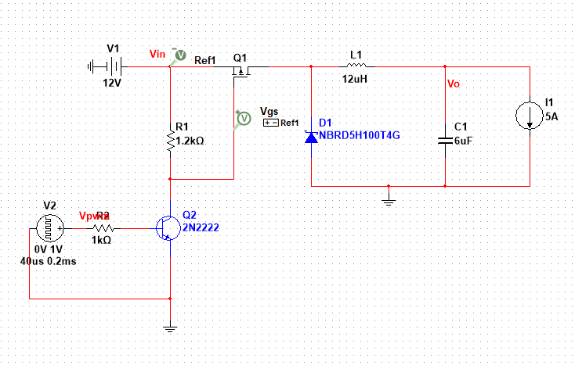
Progress Report
Designed: 12V to 5V Buck Converter rough draft with MultiSim.
Ordered: Analog to Digital Converter. (ADC08100CIMTC/NOPB), Microcontroller Dev Board (ESP32-DEVKITC-32UE), Wave Generator (AD9833BRMZ).
Researched: Oscilloscope, Multimeter, Waveform Generator, and Microcontroller.
App Development:
Several app menu pages have been designed
Began coding Bluetooth capability

Slide 11
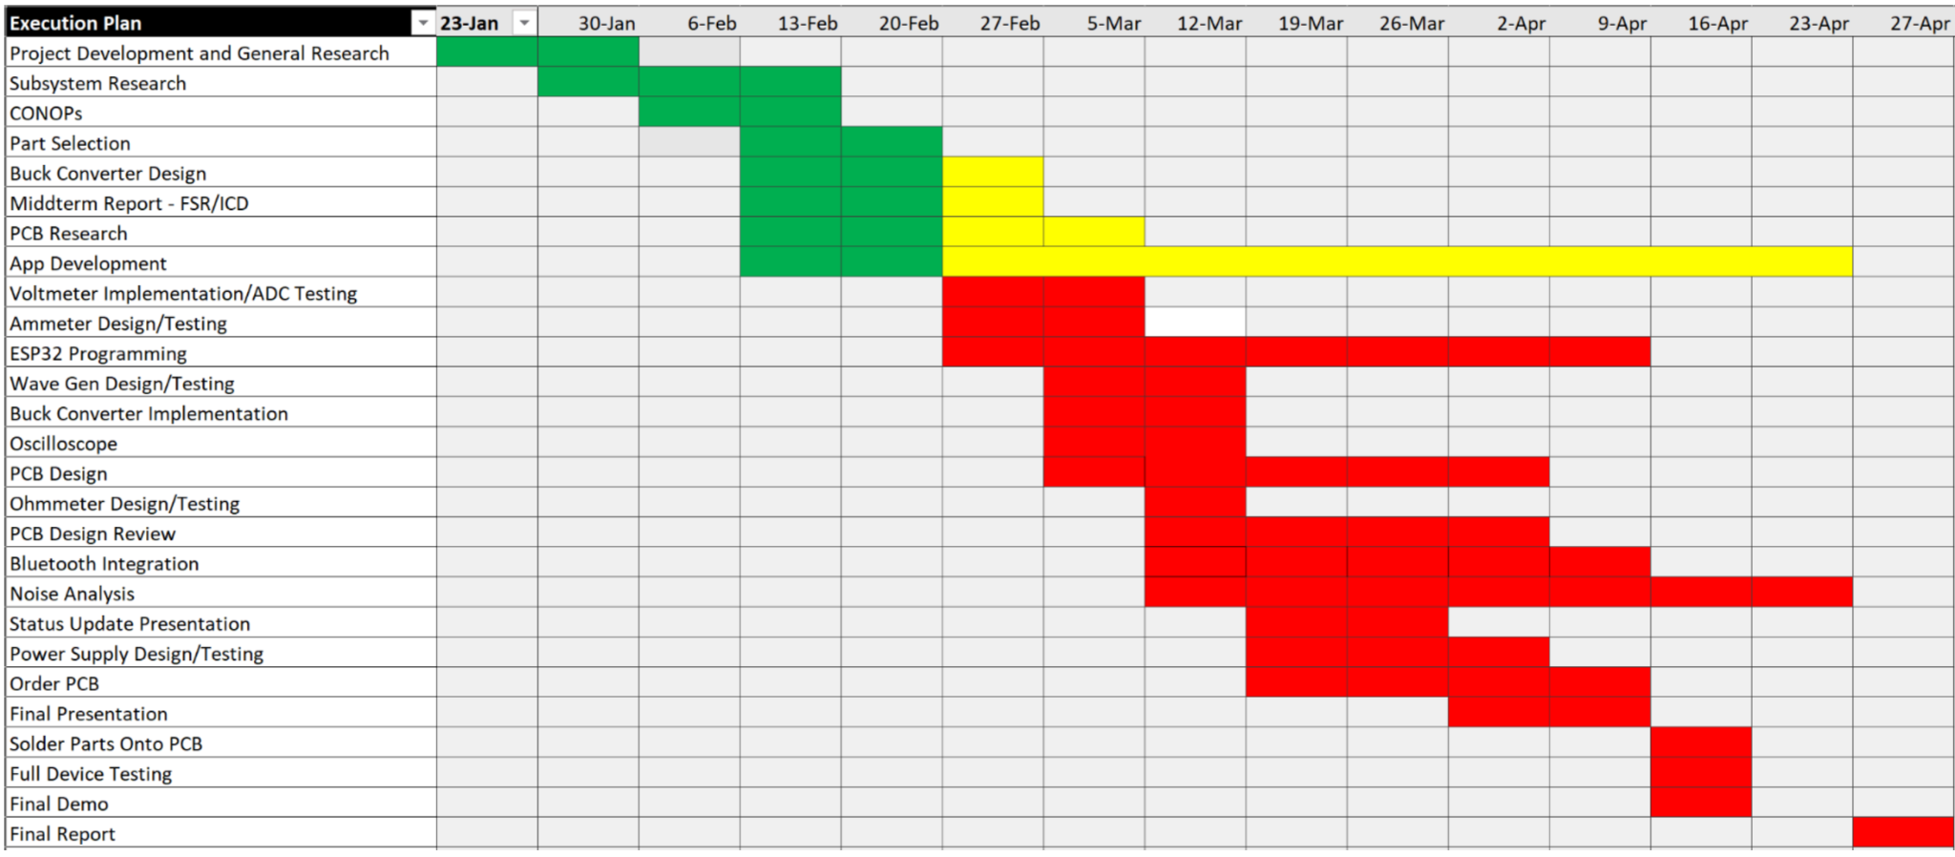
Execution plan

Slide 12
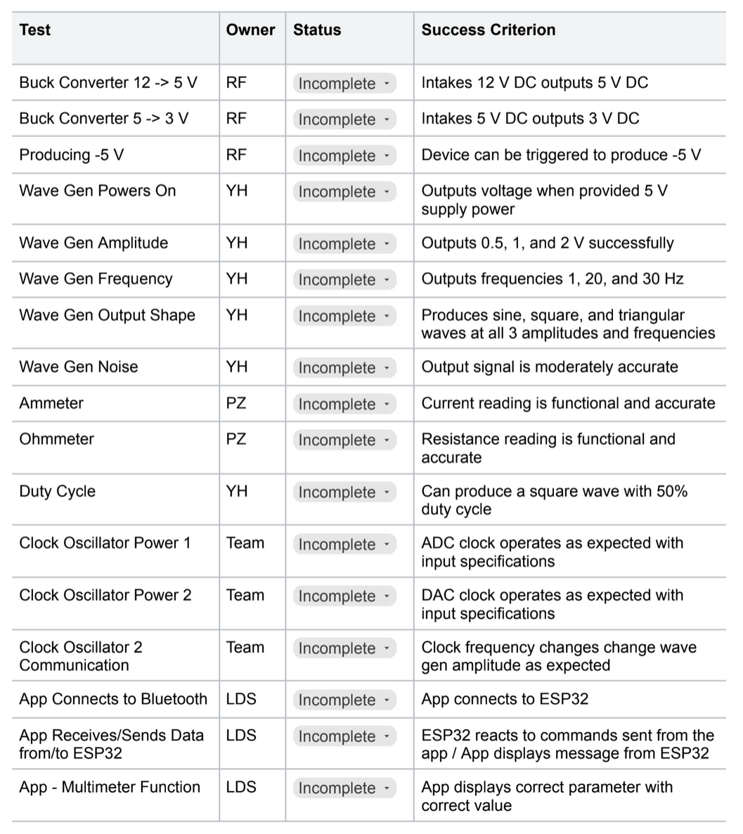
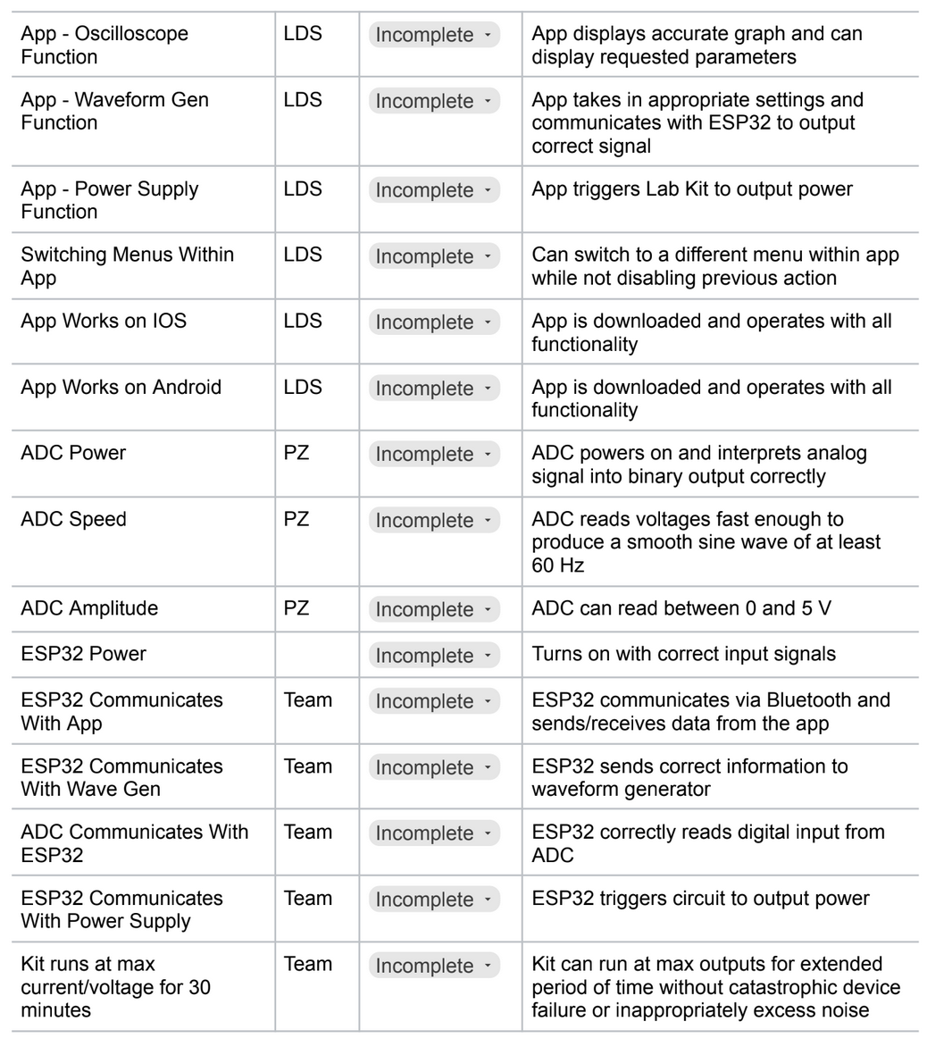
Validation plan

